Slide 1
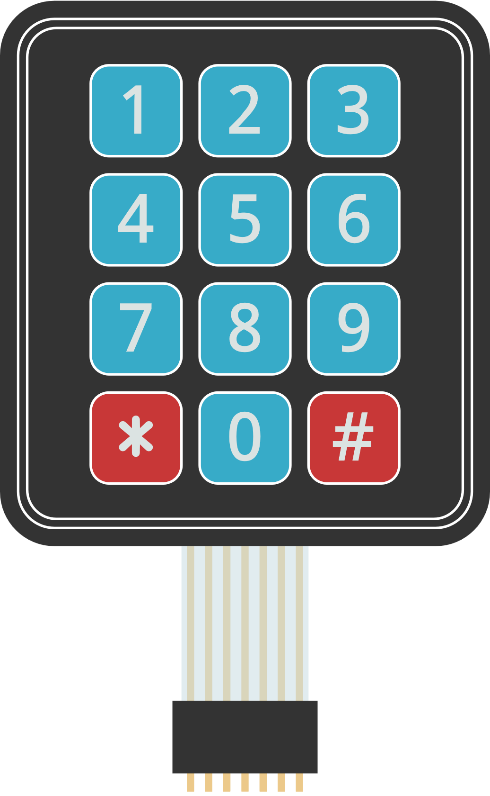
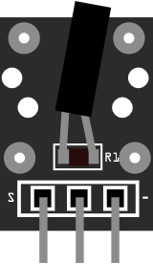
05 Tilt sensor
1 2 3
1 2 3 4 5 6 7

